Slide 1
Chapter 1.2 – Setting up your working environment
2025-2026

Slide 2
What will we be working with?
Programming language: Python
IDE: Visual Studio Code
Integrated Development Environment
Use a virtual environment in Python
Use Jupyter Notebooks
Note: This is a hands-on presentation. You are supposed to follow along.

Slide 3
Python
There are a few alternatives to Python for data science:
Julia: Python, but you can compile it, so it’s faster. Good when Python becomes too slow, but not ideal to start with.
R: Used mainly by statisticians, who were the first data scientists. Feels strange at first but is a very powerful language to work with data (importing/cleaning/creating graphs). Preferred language to use in Business Intelligence tools.
We chose Python because it’s widely used and because you have good coding skills in that language.

Slide 4
Windows, Linux or MacOS?
Our examples and screenshots will always be made on Windows
And we know our code works on Windows
Because the teachers exclusively use Windows (for this course)
But the tools we use are all cross-platform
You can use MacOS or Linux
So, we decided:
You’re free to use any OS you like
If you have any issues with your code, we will help you figure out what’s going on
But we reserve the right to say “I can’t find the problem so it’s probably because you don’t use Windows. You figure it out.”
Notes:
Or you could install linux (without a gui) on a PC at home and leave it always on. Then buy the cheapest (or lightest) laptop you can find and install a tailscale tunnel on both the PC and the laptop. In class you always open a remote session from the laptop to the PC and work on the PC without noticing. This means you’ll have the raw processing power of a PC combined with a lightweight device. Win-win!

Slide 5
Installing Python
Go to https://www.python.org/downloads/
Download the latest version
DO NOT quickly click ‘next’ through the installation!
Check the following slides

Slide 6
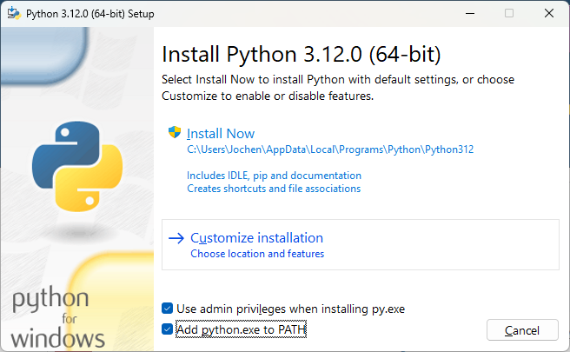
Installing Python
First screen:
“Add Python to path”
Click “Customize installation

Slide 7
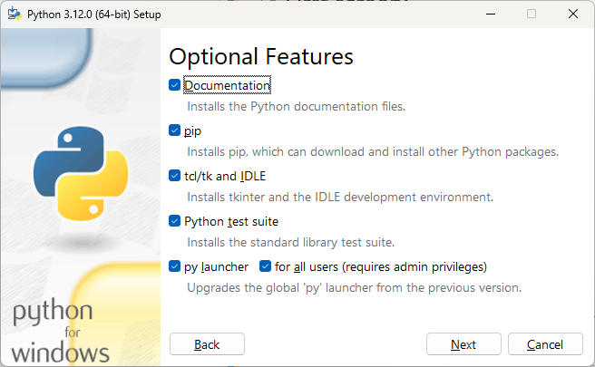
Installing Python
Leave the following screen as it is

Slide 8
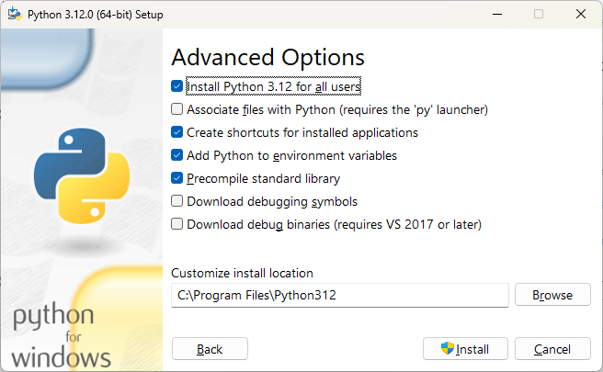
Installing Python
Select “Install Python for all users”

Slide 9
Visual Studio Code
Microsoft has the Visual Studio IDE since the nineties
Big, bulky program that only runs on Windows
But recently they released Visual Studio Code
Small and efficient
Open source
Works on any operating system
Can be used for any programming language (through plugins)
Integrates with GitHub
Can be used on a remote system
In this course you work with Visual Studio Code
Notes:
https://www.youtube.com/watch?v=hilznKQij7A&list=PLj6YeMhvp2S6uB23beQaffszlavLq3lNq
https://vscode.dev/

Slide 10
Installing Visual Studio Code
Go to https://code.visualstudio.com/
Download the latest version for your operating system
Install using the default settings
Alternatives
Install using https://ninite.com/
Install as a portable app
Theoretically: use https://vscode.dev/

Slide 11
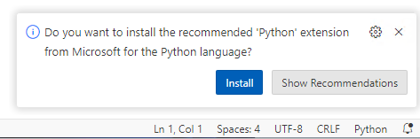
First time usage
When using VSCode for the first time, it will ask a lot
Default color scheme
Sync your settings
…
All of these can be changed later, so simply choose a nice color scheme and close the window
When starting a new type of file, there will be boxes on the lower right corner
Click “install”, it’ll make your life easier

Slide 12
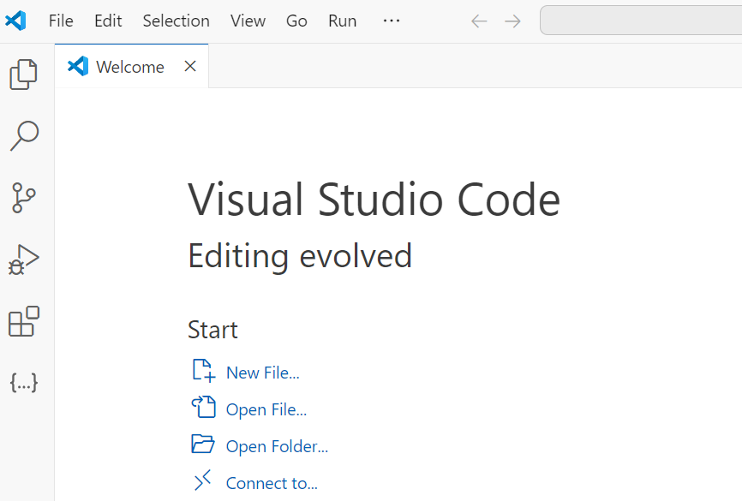
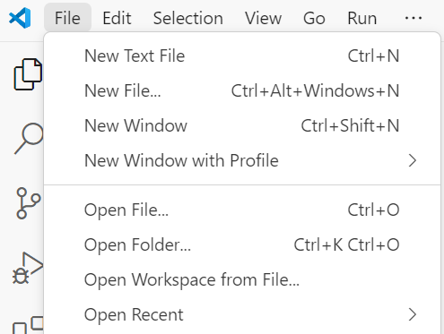
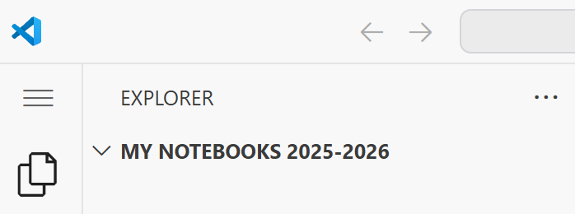
Creating your first Python script
Create a folder for your Data Science projects
By opening this folder in VS Code, it becomes your "workspace".

Slide 13
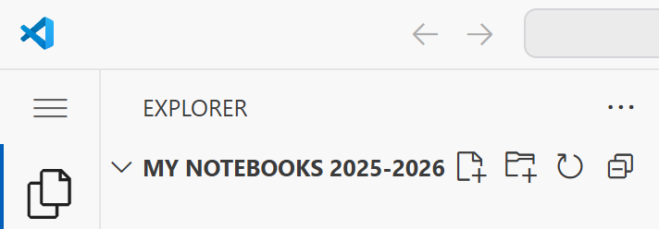
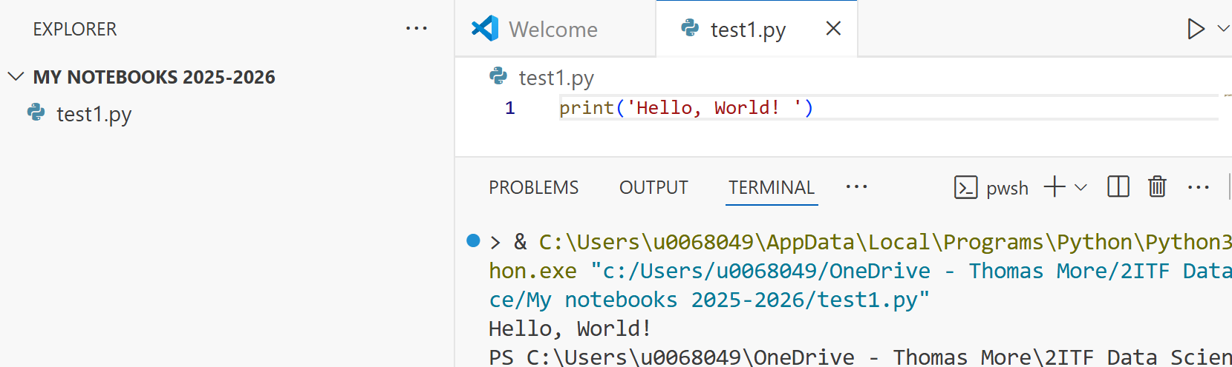
Creating your first Python script
Click the “New file”-icon
Call the file “test1.py”
Add Python code that prints “Hello, world!”
Run the code using the “play”-button in the upper right corner
v
v
v

Slide 14
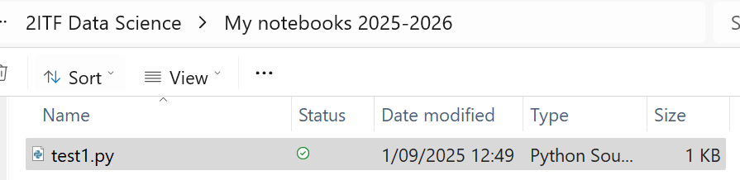
Creating your first Python script
The code runs in a terminal below
The file is also saved in your folder
When creating Python-scripts, this is the way to work

Slide 15
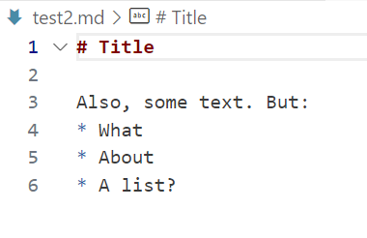
Creating your first Markdown file
Markdown is a way to style text using only simple markers, to help you write formatted text without using Word or HTML
In your workspace folder, create a file and call it “test2.md”
Add the following to the file

Slide 16
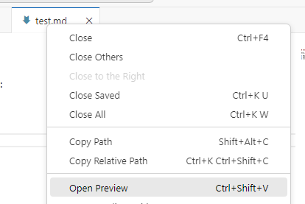
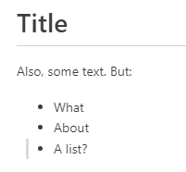
Using markdown files
Save the file and right-click the tab, choosing “Open preview”
The output will be the same file, but formatted
There are tags for adding code, images, links, …

Slide 17
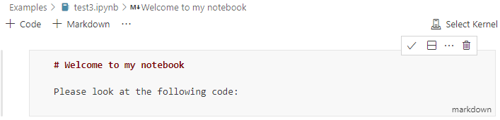
Creating your first Jupyter notebook
We did code and we did markdown, but can we combine them?
Yes! It’s called a Jupyter notebook
Create a new file called “test3.ipynb”
Add a markdown-cell and add some markdown-text
Click the checkmark on the top right to display formatted text
Double-click the formatted text to edit it again

Slide 18
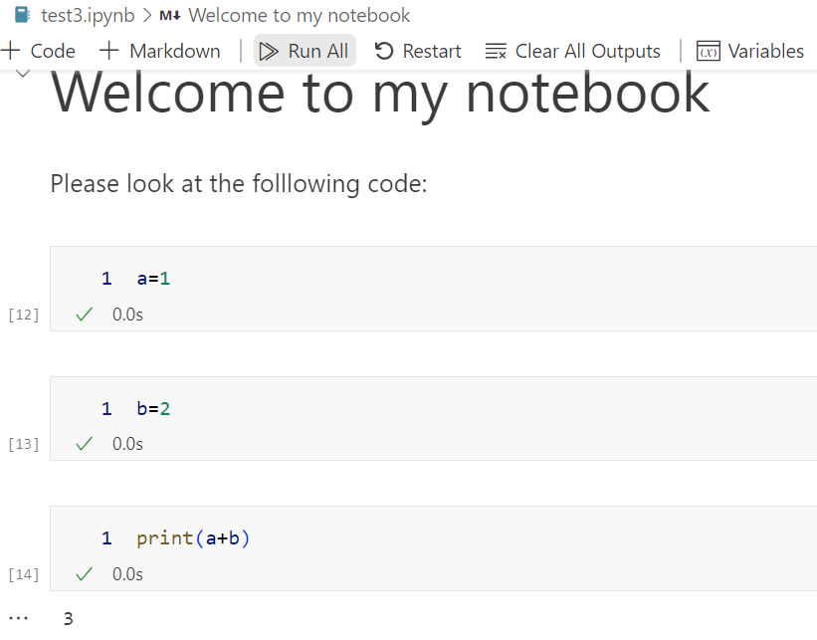
Creating your first Jupyter notebook
Add 3 code-cells:
In the first cell put “a = 1”
In the second cell put “b=2”
In the third cell put “print(a+b)”
Run the cells
Note how the variables you made in cell 1 and cell 2 still exist in cell 3
This is the big strength of Jupyter notebooks: you can write code and define variables in one cell and reuse these variables differently in subsequent code cells

Slide 19
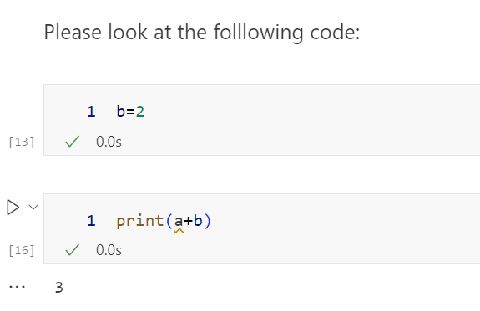
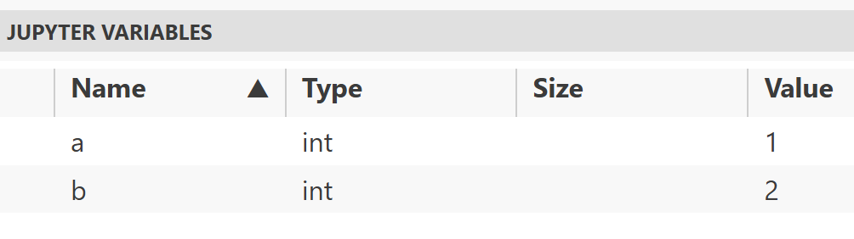
Using Jupyter notebooks
Delete the first cell
Now run the third cell again!
The print still works!
This is a pitfall: it’s not because you deleted a cell that the result of that cell is gone. The Jupyter variables still exist and can still mess up your results.

Slide 20
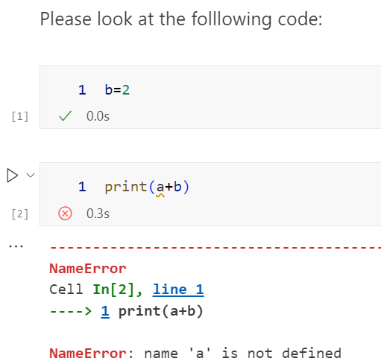
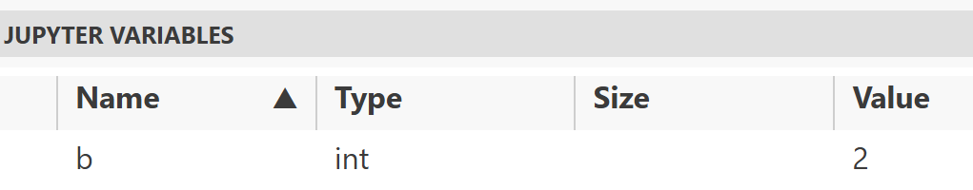
Using Jupyter notebooks
If you want the variable ‘a’ to be cleared from memory, you must restart the kernel

Slide 21
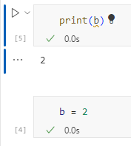
Using Jupyter notebooks
In the first cell put “print(b)”
In the second cell put “b = 2”
Run the second cell first and the first cell last
Works!
Another pitfall: when developing you code in different cells. That is fine but remember to always end up with a notebook that you can run top to bottom.
It’s impossible, or at least very frustrating, to recreate the order in which you ran cells earlier. Keep it clean and tidy.

Slide 22
Using Jupyter notebooks
When restarting all variables and functions are lost
You start over
If you are a particularly messy developer, restart your kernel by the end of the session
If you can still run all cells top to bottom, it’s fine
If you can’t anymore, something is wrong

Slide 23
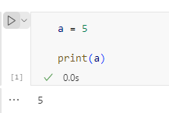
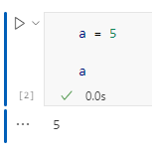
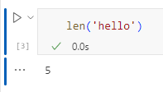
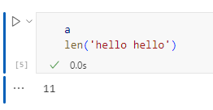
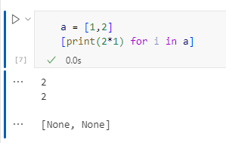
Using Jupyter notebooks
To print the contents of a variable, you can use print()
But notebooks also print the output of whatever the last statement in the code-block is
A variable
Output of a function
Note however
This only works with the last function
If the last function has no return-value, None is printed
Variable a isn’t printed!
This last row is the output of the list comprehension ->
Notes:
About the last example: It’s a list comprehension. You’ll be seeing more of these in the next chapter!
To avoid the row with “[None, None” use “dummy = [print(…”, so you’ll save the output and prevent it from printing.

Slide 24
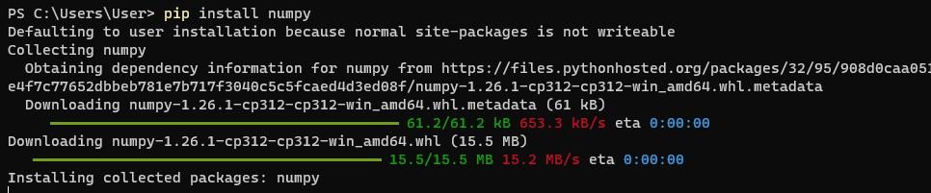
Libraries
When doing data science, you use a lot of libraries
Pandas, matplotlib, numpy, seaborn, …
These libraries are open-source packages that we can use on our own system
You can install them using pip: (Do not do this on your own system!)
Notes:
PIP is a package manager for Python packages, or modules if you like. Note: If you have Python version 3.4 or later, PIP is included by default.

Slide 25
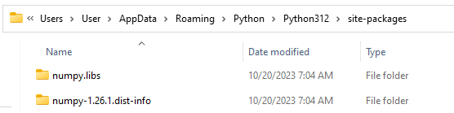
Libraries
But the problem?
We just installed numpy on our system. This means that numpy will be available on every python-session we use, and that is not a best practice.
A rule of thumb: never install packages on your system, install them in a virtual environment
And another rule of thumb: create a new virtual environment for every new project you start
Notes:
The reason is mainly version management. Suppose we have a notebook now that works with numpy version X. We upgrade our local python installation, install numpy version Y and all of a sudden our notebook doesn’t work anymore! If version X had been installed in a virtual environment that would not have been a problem.

Slide 26
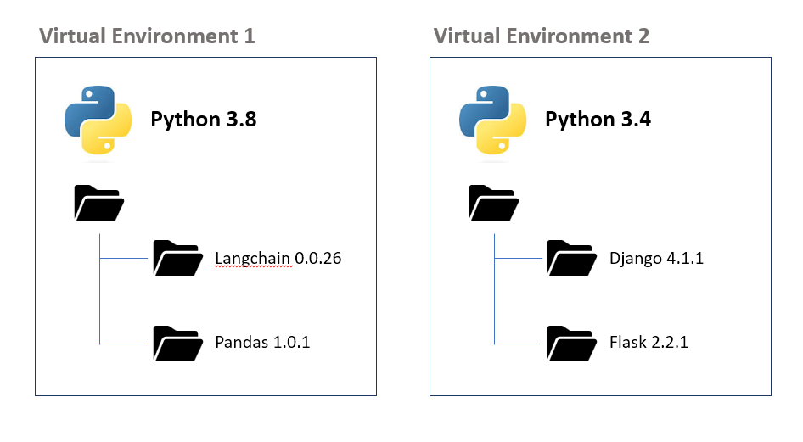
Virtual environment VSCode → What?!?
Definition:
An isolated environment where Python packages can be installed without interfering with other projects or the system itself.
Benefits:
Isolation: Prevents conflicts between packages used in different projects.
Reproducibility: Makes it easier to run your project on another machine.
Version control: Allows the use of different versions of the same package in different projects.

Slide 27
Virtual environment VSCode → How?!?
Create a new Python project:
Create a new folder for your project and open it in VSCode.
Create a new virtual environment:
Open the terminal in VSCode (View -> Terminal).
Navigate to your project folder (if you haven’t already).
Run the following command to create a new virtual environment:
On Windows: . python -m venv venv
On Unix or MacOS: python3 -m venv venv
Activate the virtual environment:
On Windows (powershell): .\venv\Scripts\activate
On Unix or MacOS: source venv/bin/activate
Select the interpreter in VSCode:
Click on the Python version in the status bar → select the interpreter in your .venv folder.
python → runs Python
-m → run a module
venv → module to create virtual env
venv (at the end) → name of folder

Slide 28
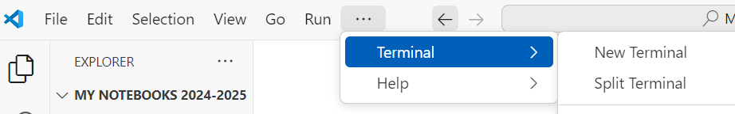

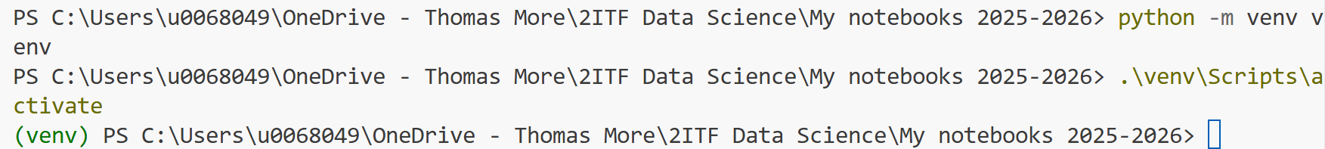
Setting up a virtual environment
This you can do on your device!
Open VSCode and select “New terminal” on top
In the terminal, type 2 commands:
Note: these are two separate commands, to be run on two different lines
The terminal changes to (venv)
Notes:
When PowerShell won’t execute the activate-script, run:
Set-ExecutionPolicy remotesigned -scope currentuser

Slide 29
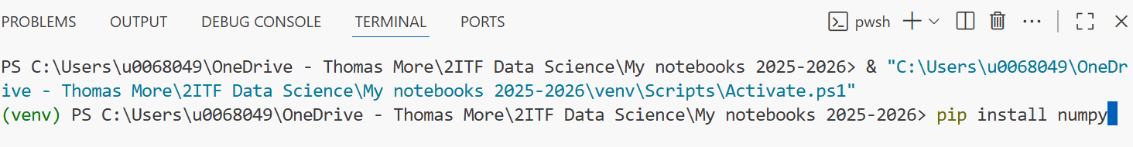
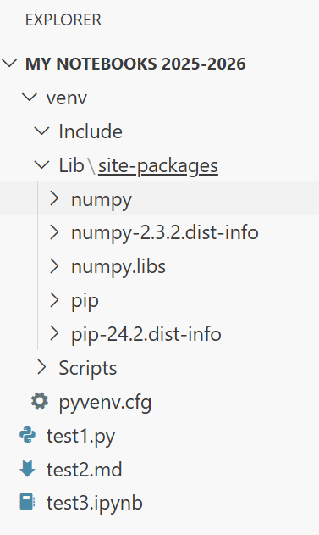
Virtual environments
When you now install a library with pip, this library ends up in the venv-subfolder:
And that is where they belong. Nice and close to the code that is using those libraries

Slide 30
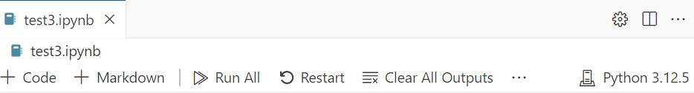
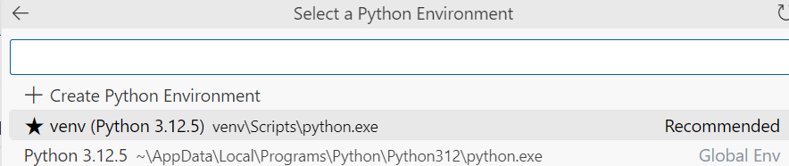
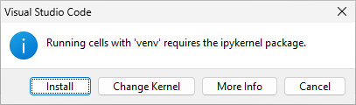
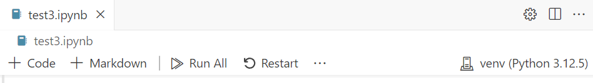
Venv in Jupyter notebooks
Once you have created a virtual environment it will be suggested as a ‘kernel’
Open ‘test3.ipynb’
Check the current kernel
Click the current global kernel to select a new one
Select your venv
(Also install the ipykernel package when asked to do so)

Slide 31
Venv in Jupyter notebooks
Every time, you open a new notebook it will ask you which kernel to use
Always select the venv you just made, never the default Python installation
Nice to know: want a venv in an older version of Python?
Install the older version of Python, but don’t let it register in the path
Create the new venv using the full path to the new (old version of) Python
That venv will from now on always use the old Python

Slide 32
Filling a venv
We’ll be using quite a lot of libraries in this course
You can install new libraries using “pip install …”
And you can run this in a code cell by saying “!pip install …”
And you can freeze an environment by using “pip freeze”
More information in the notebook called “1 - Working with a venv.ipynb”

Slide 33

Venv in GitHub
Finally, suppose you are working with a venv in a folder that is synced with GitHub, do you want to upload your venv to GitHub?
No.
You do want to run a pip freeze every now and then and upload the requirements file
To prevent uploading the venv to GitHub:

Slide 34
Debugging
https://code.visualstudio.com/docs/datascience/jupyter-notebooks
Read the above article. It will speed up your development enormously.

Slide 35
Multiline cursor
Ever needed to do the same thing on multiple lines?
Multi-Line Editing
Windows: Ctrl + Alt + Arrow Keys
Linux: Shift + Alt + Arrow Keys
Mac: Opt + Cmd + Arrow Keys
Multi-cursor editing!
press the Alt key (or Option key on a Mac) and use the mouse to place cursors

Slide 36
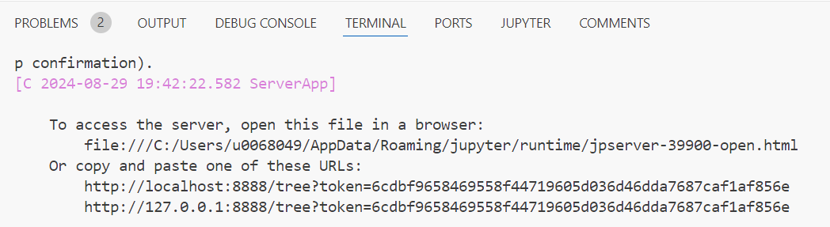
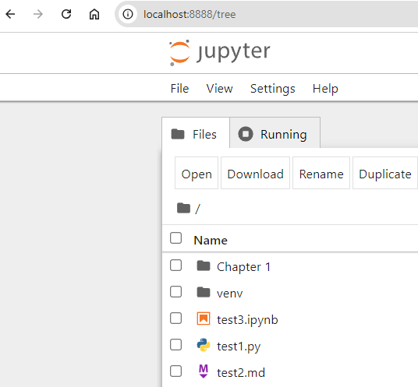
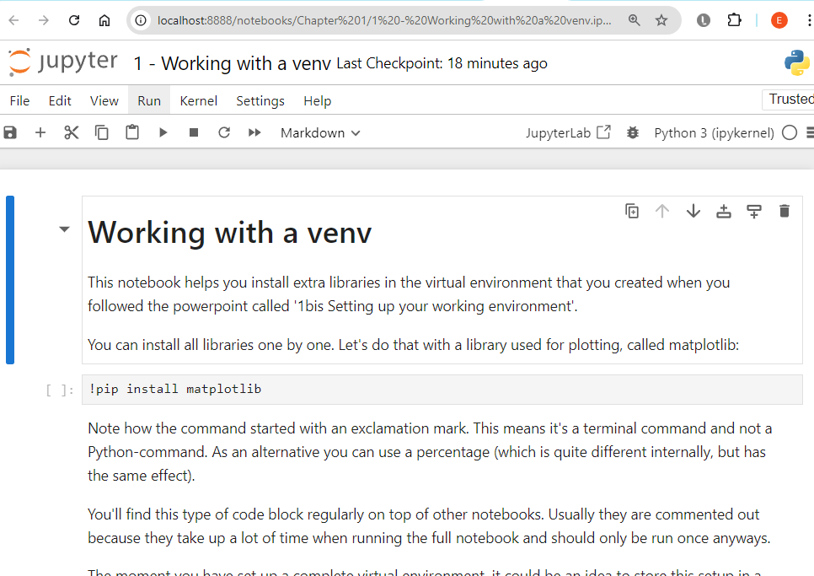
Jupyter in your browser
Tired of looking at the same VSCode interface? Try Jupyter in your browser!
In terminal:
‘pip install jupyter’
‘jupyter notebook’
Notes:
During class we prefer normal VSCode, but this is too cool not to show…

Slide 37
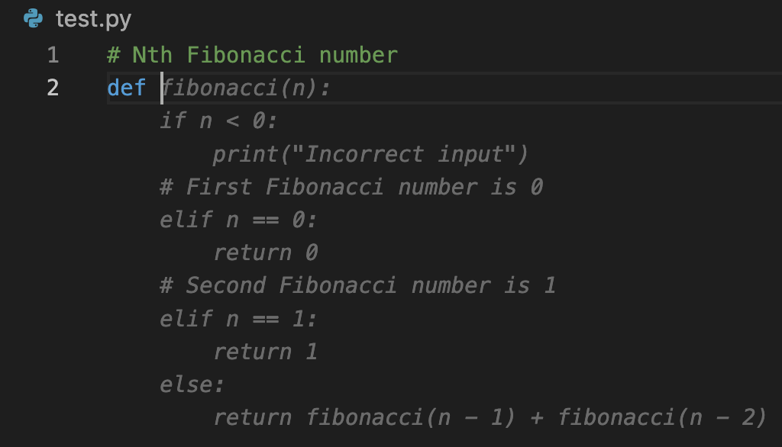
Copilot and Windsurf
Copilot and Windsurf (formerly Codeium) are two VSCode-AI plugins that will help you write code
Basically, when you write a comment, they look it up for you in Google and paste the code they found
You are allowed to use plugins when doing exercises, working out your project and taking your exam. Assessment is mainly based on comprehension and not just on correct coding syntax.

Slide 38
Summary
Setting up an IDE is always the first step when starting a new programming language
It takes some time, but is worth doing properly
You may want to start out using a simple editor when trying a new language, but a good IDE will always help you work better in the long run
After going through these slides, you’ll have a working setup
Make folders per chapter to keep it clean
You’ll be grateful for this during the exam

